Slide 1
HSA
PTR
GGO
PPY
NLE
Example of validation of shared duplications detected by WSSD strategy. FISH experiment was performed on mixed slides with human, chimpanzee, gorilla, orangutan and gibbon metaphases. The investigated region was expected to be duplicated in all species and it was confirmed as shown by fosmid ABC8_000041161100_L22 (red signals).

Slide 2
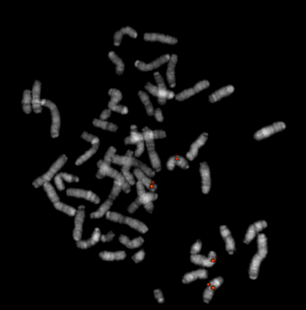
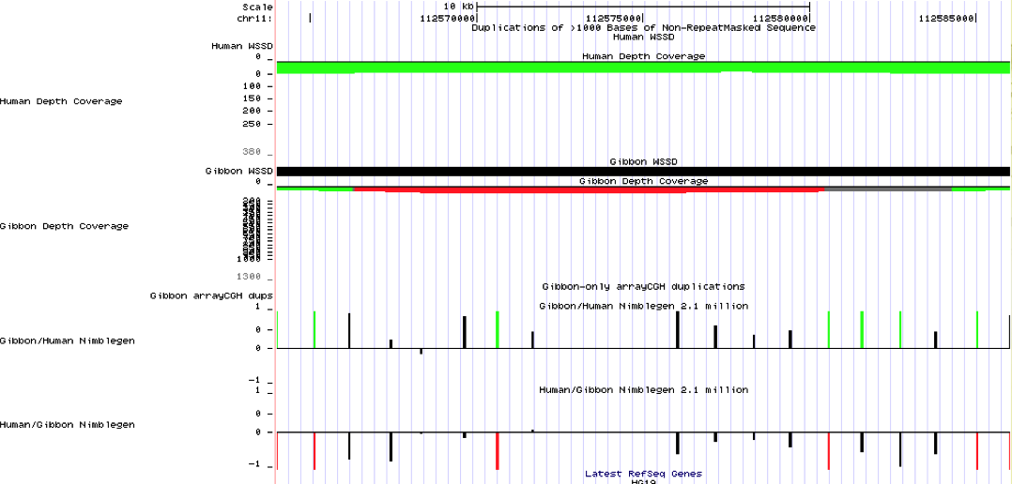
WSSD vs ArrayCGH
Chr11: 112,564,001-112,586,029 length: 22,029 bp
ABC8_000043205000_B12
On the left: Display of WSSD and array CGH results. The investigated region is duplicated in gibbon as clearly revealed by WSSD approach. Conversely, the array CGH analysis does not provide any reliable information on the duplicate state of this region. Indeed, the region is enriched of sequences that do not exceed the threshold as shown by black vertical dashes. On the right: a fosmid clone selected from the analyzed region was hybridized on gibbon metaphases showing an interchromosomal duplication distribution that confirmed WSSD predictions.

